Slide 1
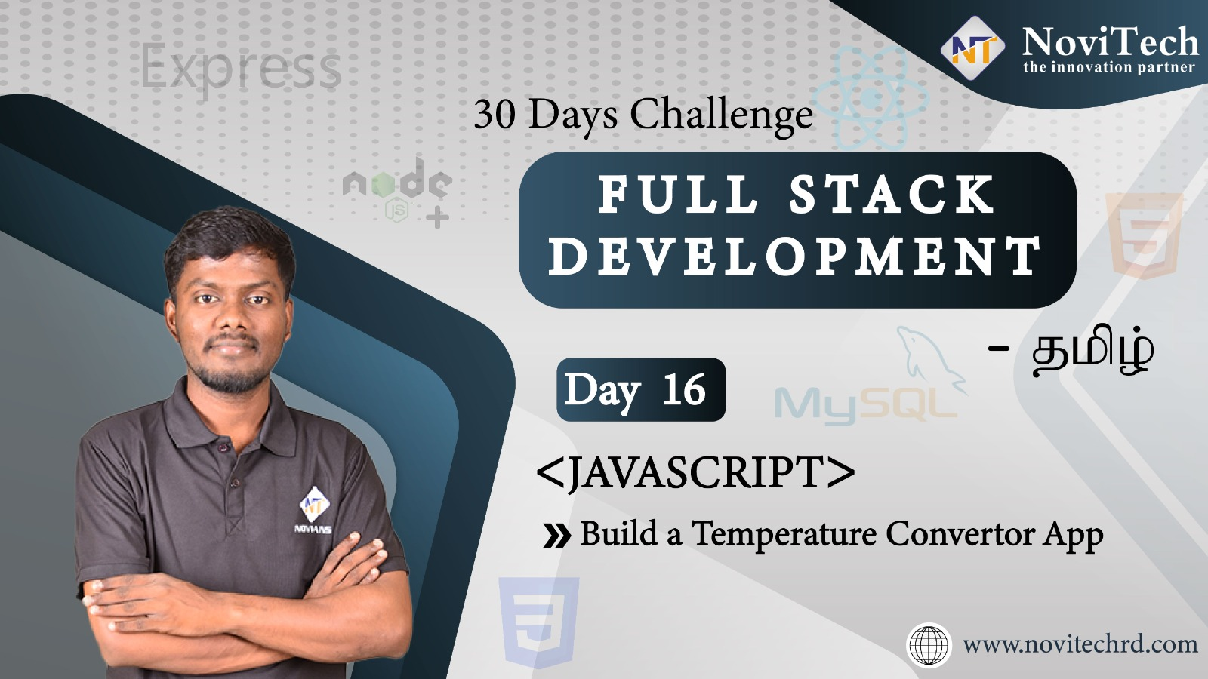

Slide 2

Announcement
ATTENDANCE LINK will be shared in between session
Minimum 28 DAYS Attendance required to receive your
FREE E-CERTIFICATE

Slide 3
Prerequisites
Laptop with Internet Connection
No Prior Knowledge is required
Note & Pen

Slide 4
JavaScript output
document.write()
console.log()
window.alert()
alert()

Slide 5
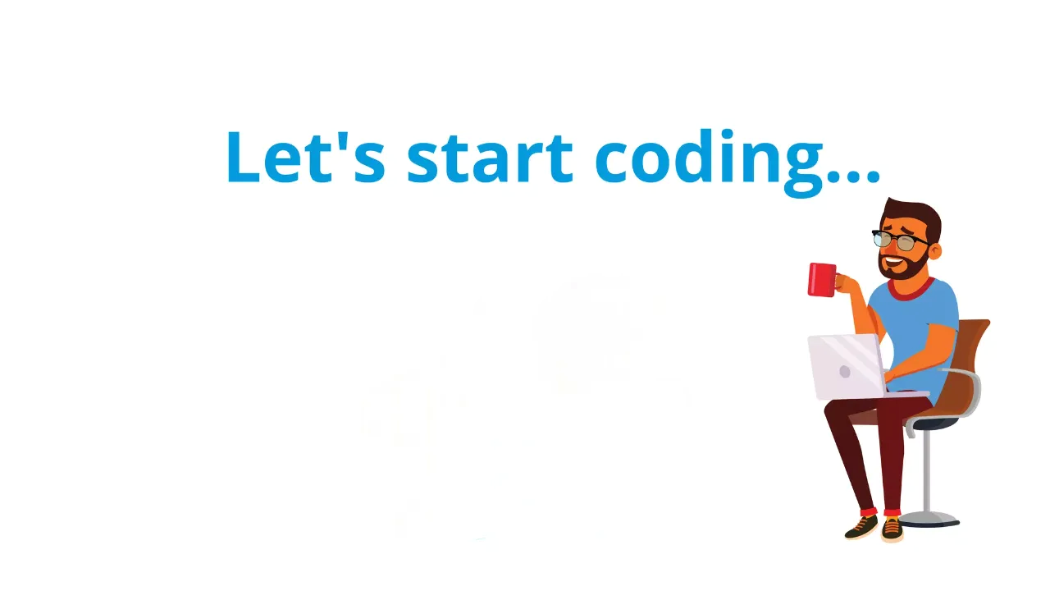

Slide 6



Slide 7



Slide 8
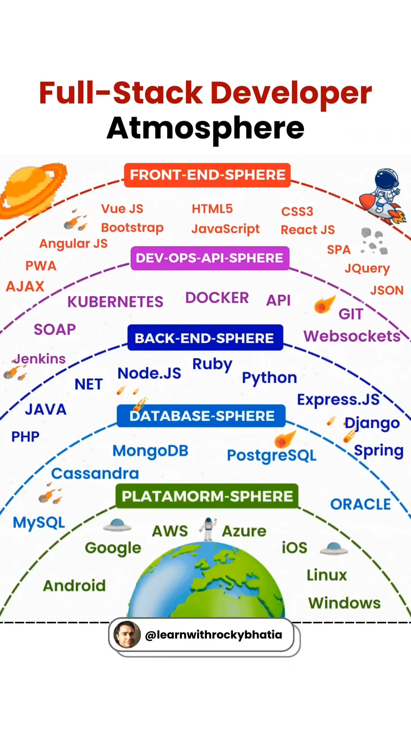

Slide 9

wonder word
Mindset

Slide 10


Slide 11



Coding Competition
BEST WEBSITE CREATION

Slide 12




THANK YOU☺
JOIN WhatsApp community
novitechresearchanddevelopment

Slide 13
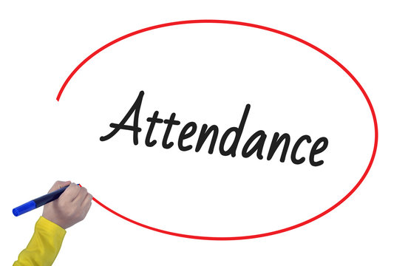
Post Your Attendance

Slide 14


